Slide 1
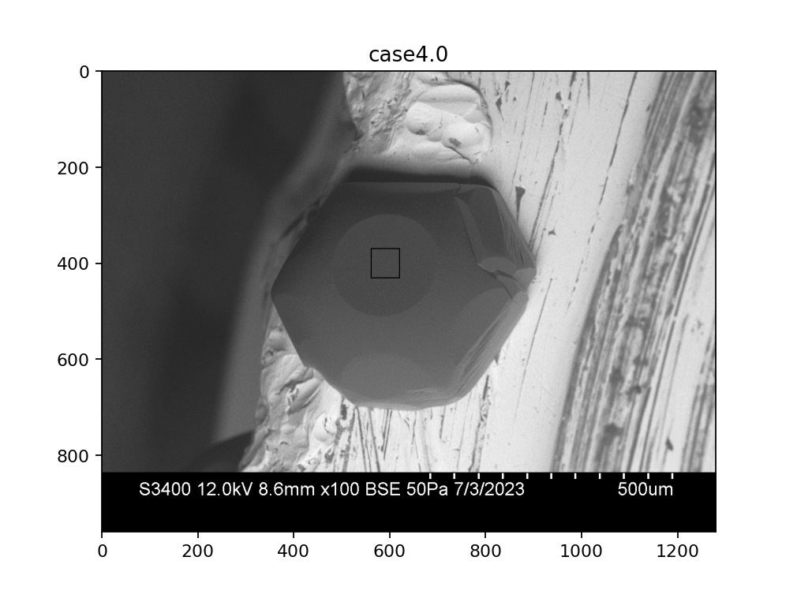
D
B-detector image
A
C
B

Slide 2
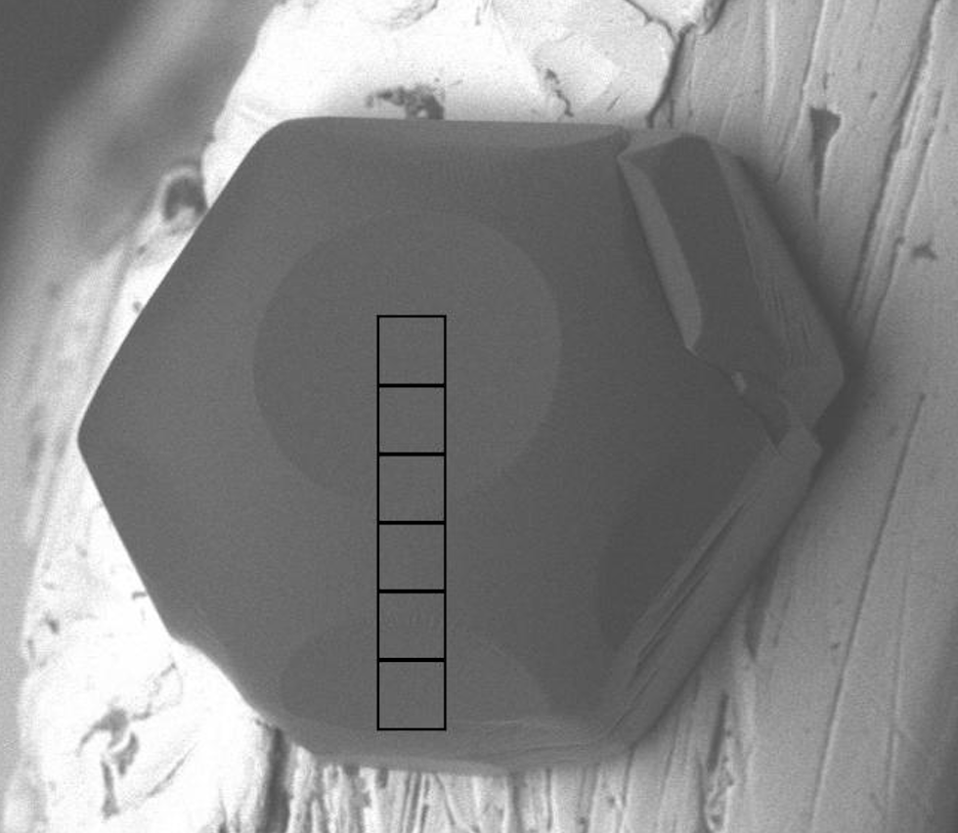
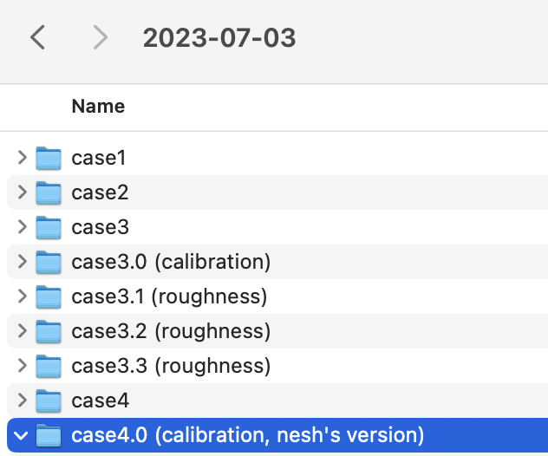
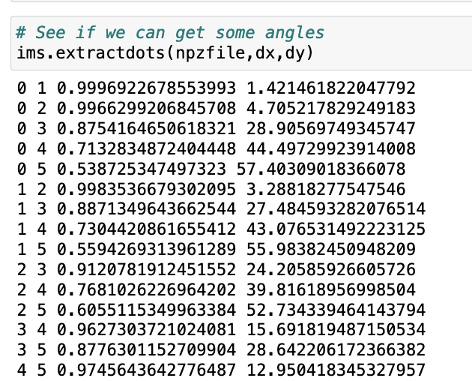
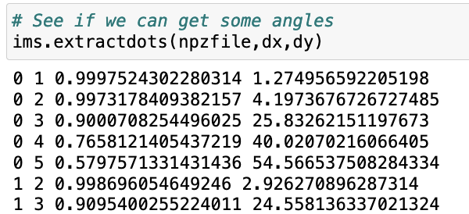
Using ABCD = 17º
0
5
Observations:
Use of ABCD=17º (“Angle Between Detectors”), as specified in GNBF_2_calibrate_from_Xtlvecs, produced a more accurate retrieved basal-to-pyramidal angle (57.4º) than produced by ABCD=15º (54.6º). There’s an upper limit, however: when I tried ABCD =20º, the retrieval algorithm failed in segment 5.
On the other hand, smaller ABCD values produce smaller retrieved angles, so I don’t want to go that direction.
Consistent with this, apparent concave curvature of the center of the basal facet (see next slide) also increases with ADA. Therefore, the more accurate ABCD =17º will produce a slightly more concave surface. We conclude that the concavity we observed at ABCD =17º is “real” (i.e., not an artifact of a bad value of ABCD).
Using ABCD = 15º

Slide 3
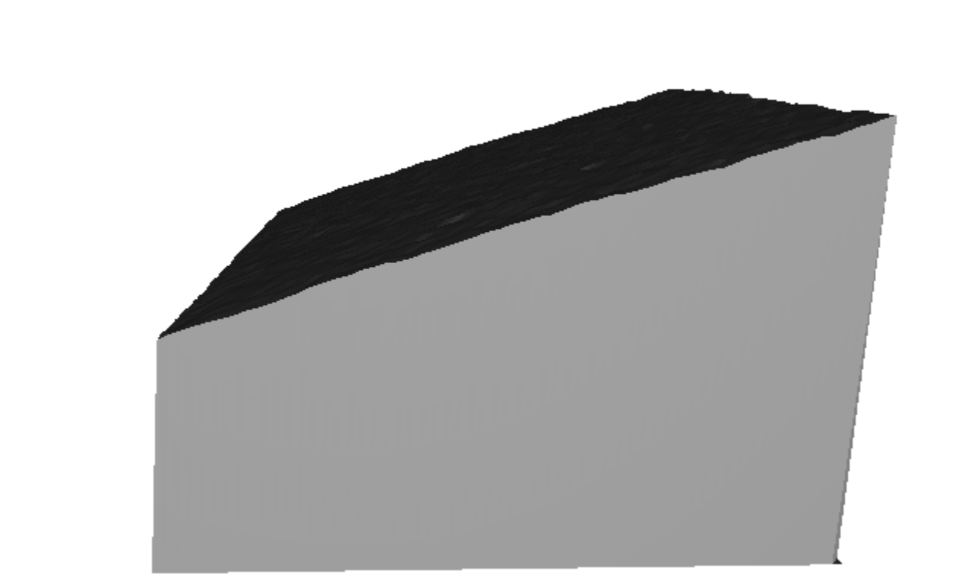
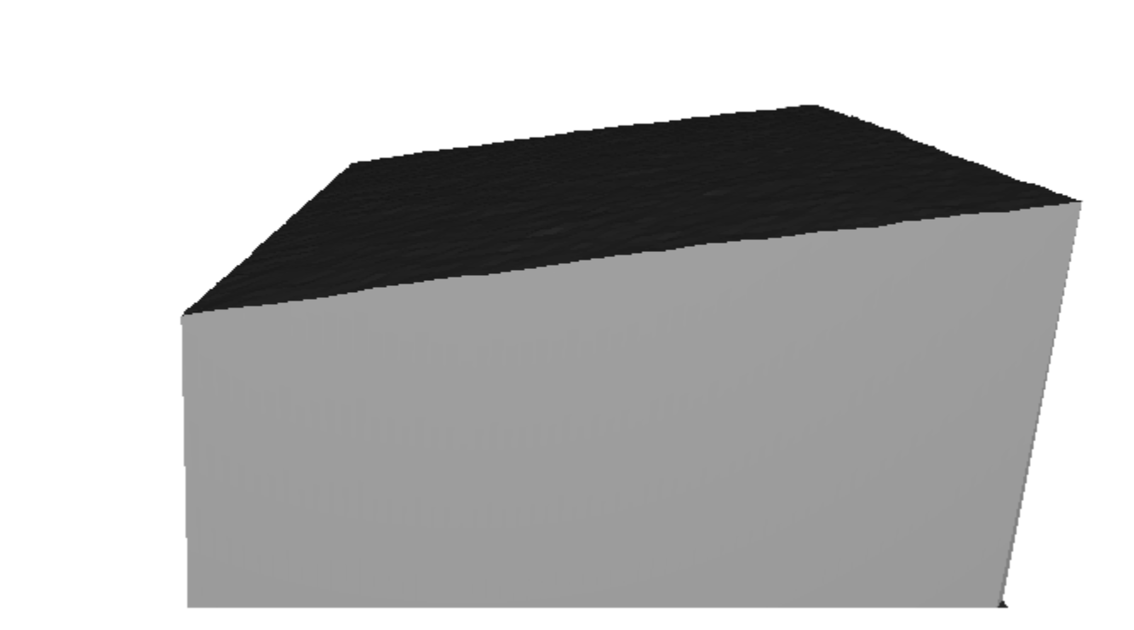
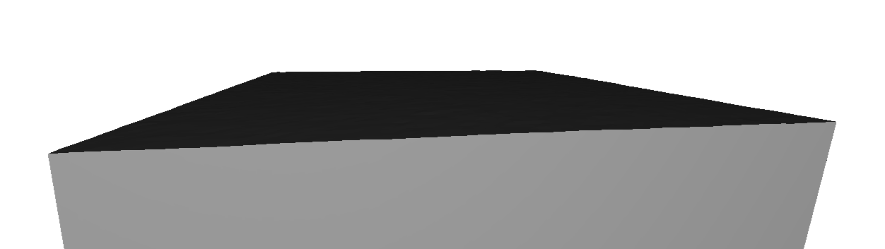
This is segments4, using ADA=25º
This is segments4, using ADA=15º
This is segments4, using ADA=5º

